Slide 1
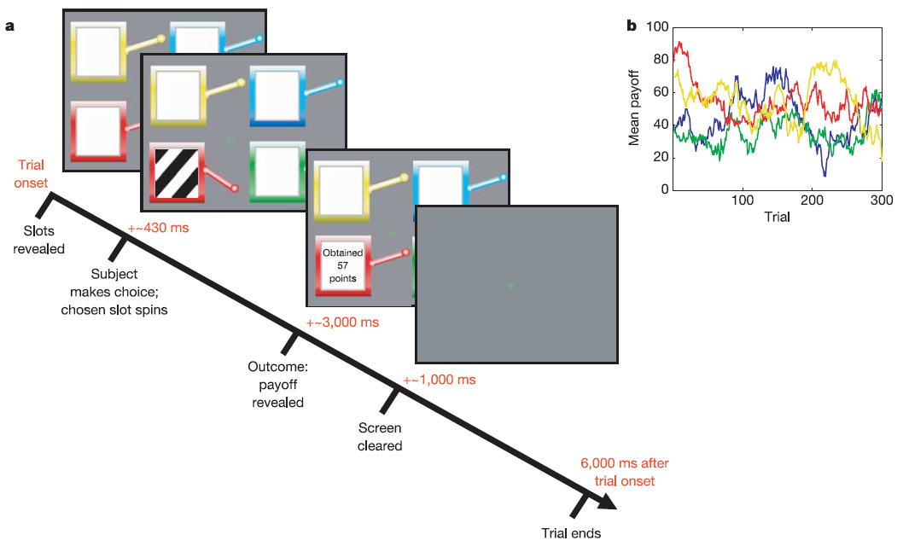
Bandit Reward Learning Task
Daw et al., (2006) Nature

Slide 2

Bandit Reward Learning Task
You Win
Decision
Confirmation
Outcome
ITI
Task-irrelevant stimulus appear in
the outcome phase for sometime

Slide 3

Bandit Reward Learning Task

Slide 4
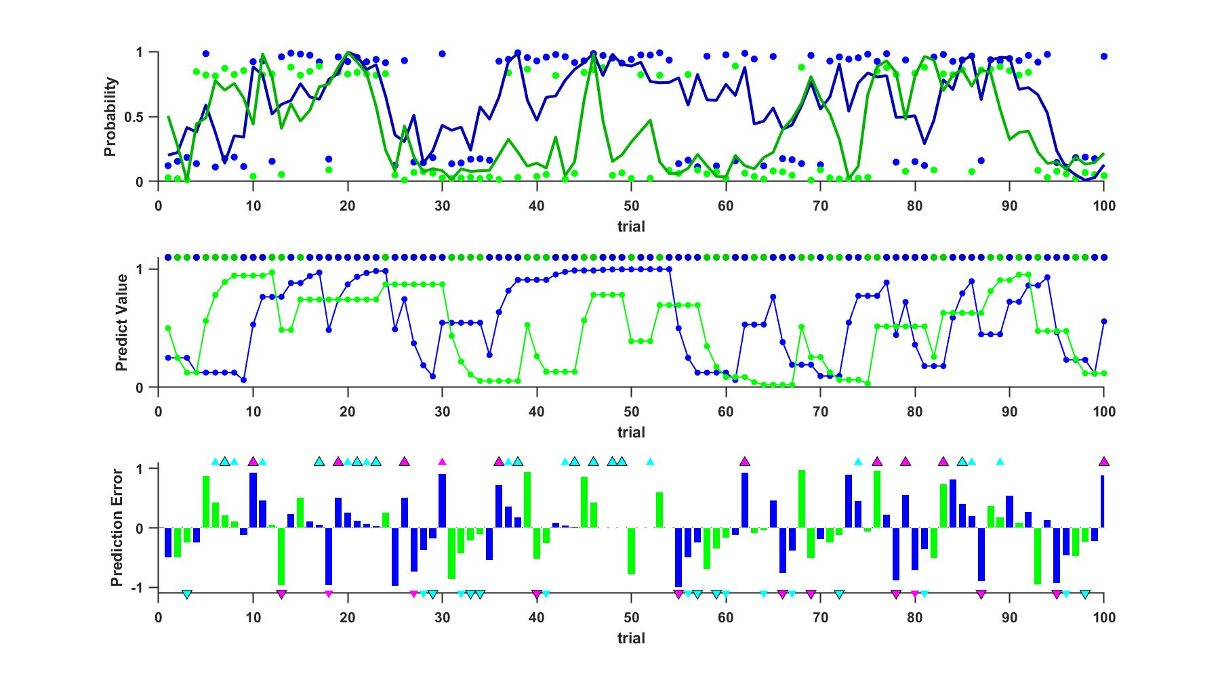
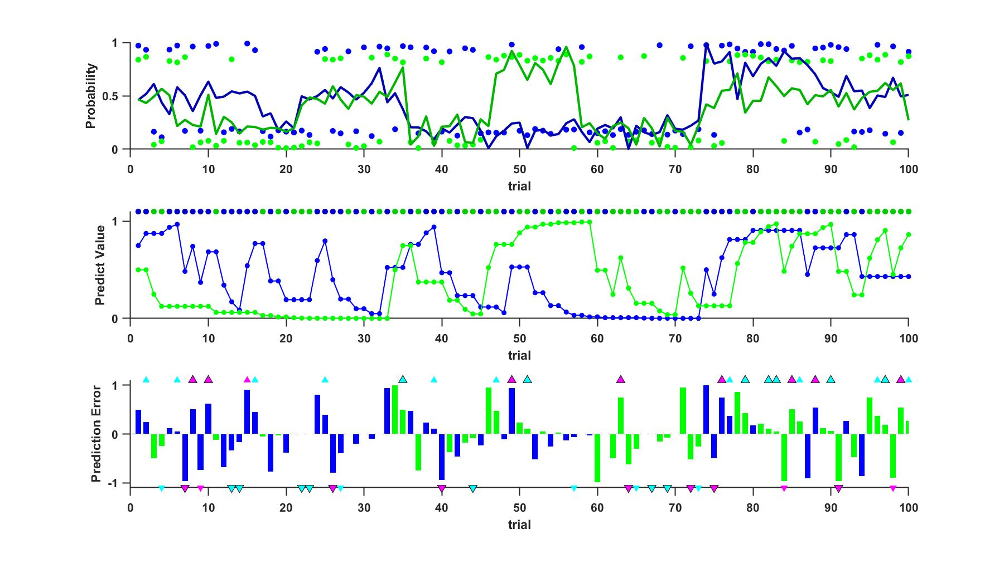
Reward winning Probability
A. Random walk within 10%~90%
B. Random change between 3 probability levels: high (85%), mid (50%), low (15%) at some point (set randomly)

Slide 5
Simulation
Agent: e.g., learning rate = 0.5;（liJIan） SoftMax function beta =1
Plan A: Random Walk

Slide 6
Simulation
Agent: e.g., learning rate = 0.5; SoftMax function beta =1
Plan B: Random Change

Slide 7






Small-Positive (SP) Prediction Error
Occur when the participants continue to choose the same slot machine and keep getting reward twice and more
Group 1:
······
Small-Negative (SN) Prediction Error
Continue to choose the same slot machine
and keep not getting reward twice and more
Group 2:
······
Big-Positive (BP) Prediction Error
Continue to choose the same slot machine and keep not getting reward twice and more, but suddenly get the reward…
Group 3:
······
Big-Negative (BN) Prediction Error
Continue to choose the same slot machine and keep getting reward twice and more,
but suddenly not…
Group 4:
······

Slide 8
Plan A: Random Walk

Slide 9
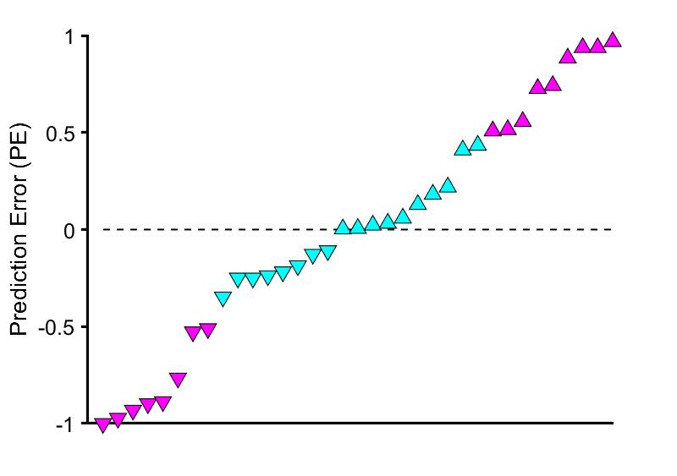
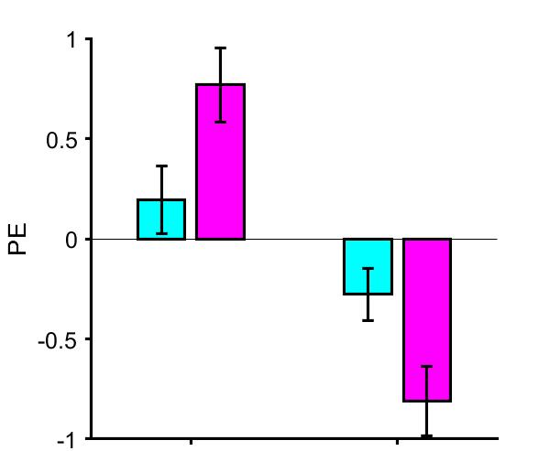
Plan A: Random Walk
Totally Random
Muti-modality

Slide 10
Plan B: Random Change

Slide 11
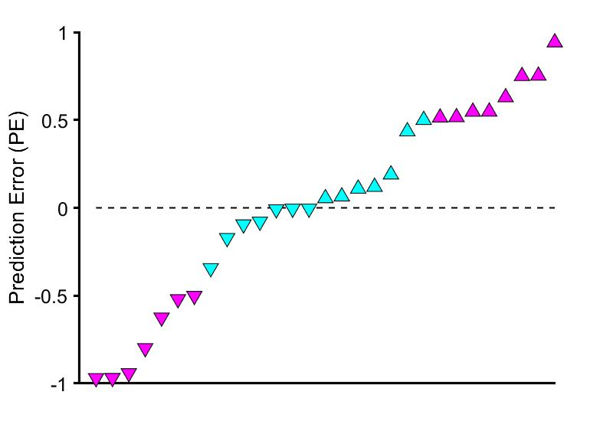
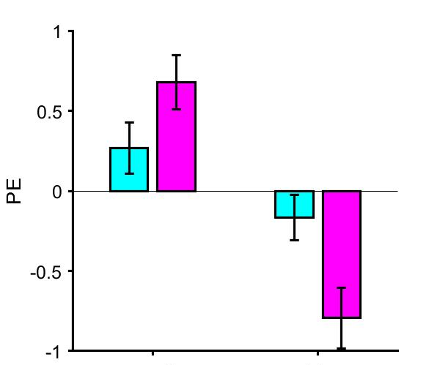
Plan B: Random Change

Slide 12
Surprise tests
Plan A:
Preference task：
2AFC Task
Which do you prefer？
Memory Decay?
Memory test occurs after a session of preference
task？
Old New
How confident？
Old New
How confident？
Memory 1
Confidence 1
Memory 2
Confidence 2

Slide 13
Surprise tests
Picture & tone （~30 trial）
MEMORY

Slide 14
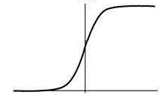
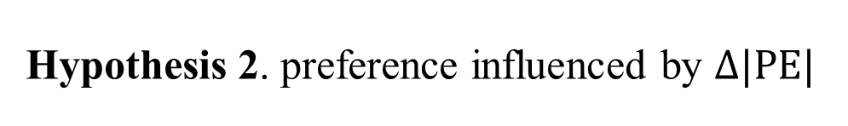
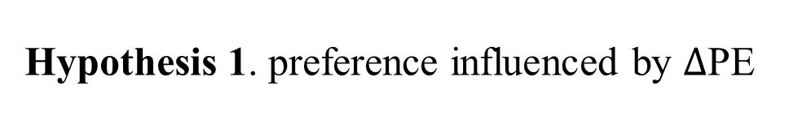
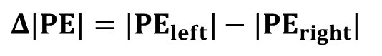
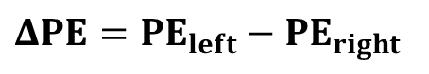
Hypothesis
Hypothesis 1. preference influenced by $Δ$PE
Hypothesis 2. preference influenced by $Δ|PE|$
P(Choose Left)
P(Choose Left)
-2
0
2
-1
0
1
$ΔPE={PE}_{left}−{PE}_{right}$
$Δ|PE|={|PE}_{left}|−|{PE}_{right}|$

Slide 15
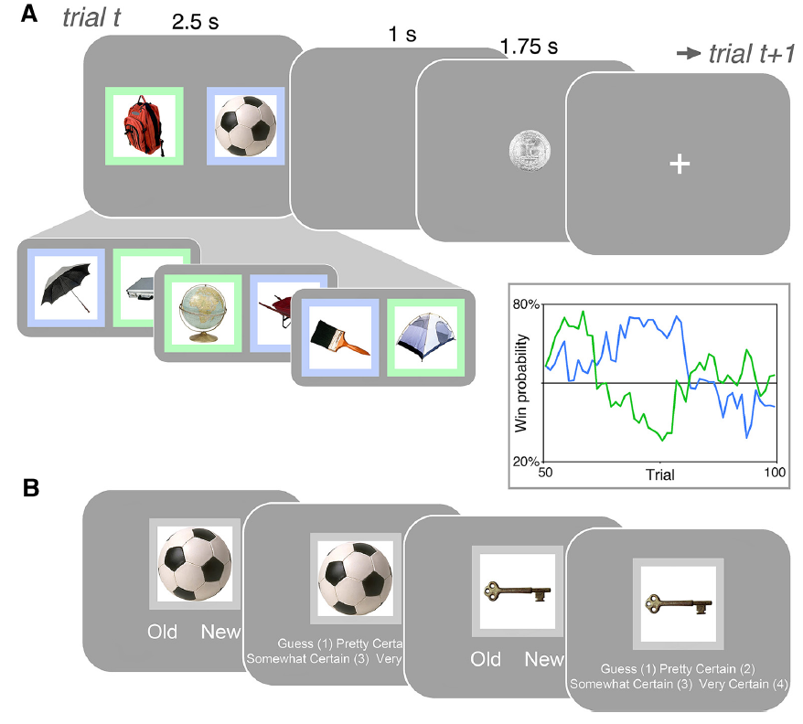
Behavior: better episodic memory was associated with worse reward-based updating in RL.
fMRI: during learning the canonical striatal reward prediction error signal was significantly weaker when episodic memory was stronger.
This decrease in reward prediction error signals in the striatum was associated with enhanced functional connectivity between the hippocampus and striatum at the time of choice.
Wimmer et al., (2014) J Neurosci.

